Slide 1
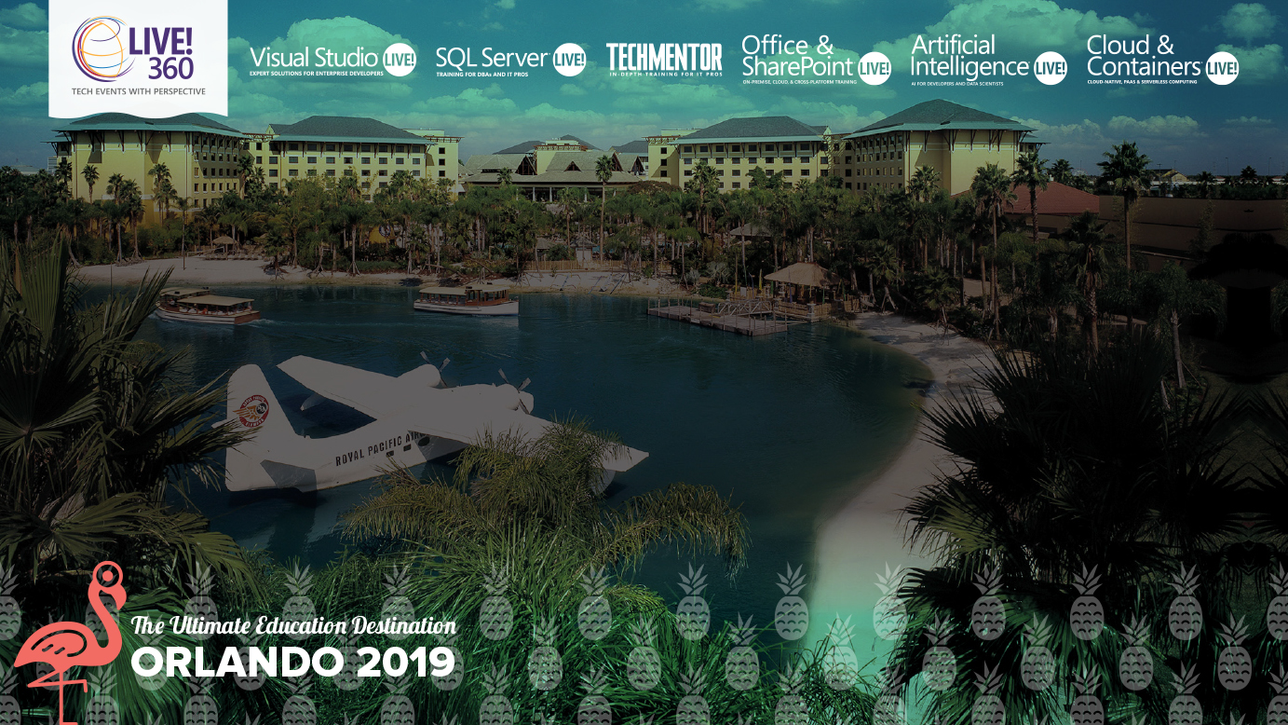
How Cloud Native Impacts your Development, Deployment and Operations
Steve Lasker
Program Manager
Azure Container Registries
Steve.Lasker@Microsoft.com
@SteveLasker
SteveLasker.blog
Notes:
Containers have become the modern packaging format, regardless of the host they're run on. You may be building your own images, or consuming images from ISVs. While containers have a focused subset of their VM ancestors, containers still have layers of the OS, runtimes and other components that are susceptible to vulnerabilities that must be remediated. Have you considered how you'll patch these deployments? Will you patch the running containers, as you patch VMs, hoping the software continues to run, as you continually patch the same deployed image?
We'll examine leveraging your build and deployment pipelines to automatically patch, test and deploy updates, during and long after you've moved onto another project. OS & Framework Patching can be an extension of what you're already doing today.

Slide 2

Cloud native is the new paradigm of software development
35
>
%
of all production apps will be cloud-native by 2022¹
¹IDC FutureScape, 2018
Notes:
SPEAKER: New paradigm of application development
The rapid rise of new digitally native businesses have disrupted traditional business models and destabilized established companies and industry sectors. The grounds for competition have changed – enterprises are increasingly defined by the way they build software. Challenger banks, online healthcare providers, e-commerce leaders and other upstarts are winning customers by providing new applications.
All these trends have yielded a new paradigm of software development called cloud native.
IDC predicts by 2022, 35% of all production apps will be cloud-native vs. less than 10% today
IDC: https://www.idc.com/getdoc.jsp?containerId=prUS44417618

Slide 3

Cloud Native
What…
Why…

Slide 4

What
is
Cloud Native
?
Infra Deployed As “Code” Infrastructure provisioned as needed
Containers
Standard deployment format to abstract code from underlying infrastructure differences
Polyglot
Mixture of languages & runtimes, tailored to the development team, and/or task being done
Failure As A Design Principal
Standard deployment format to abstract code from underlying infrastructure differences
APIs
Expose services as light-weight APIs for easier integration
Serverless
Instancing infrastructure, on-demand, paying for usage over reserved capacity
Microservices
Loosely coupled services, using fire & forget queue processing with apology-based transactions
Automation
All process, from build, patching, test, deployment are automated
OSS
Embraces community projects to speed development
Notes:
SPEAKER: What is cloud native
‘Cloud-native’ is an adjective that describes the applications, architectures, platforms/infrastructure, and processes, that together make it economical and possible for us to quickly respond to changing landscape and growing customer needs.
In simple terms, it is application code and dependencies packaged in containers, deployed as microservices, and exposed as APIs. And you can manage them using DevOps processes and tools.

Slide 5
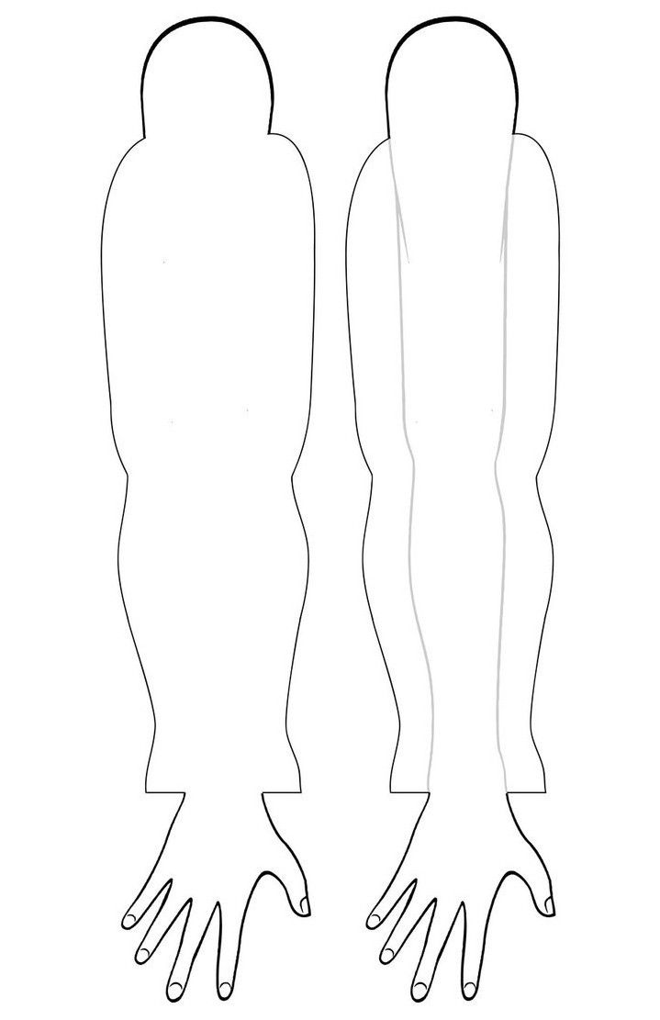
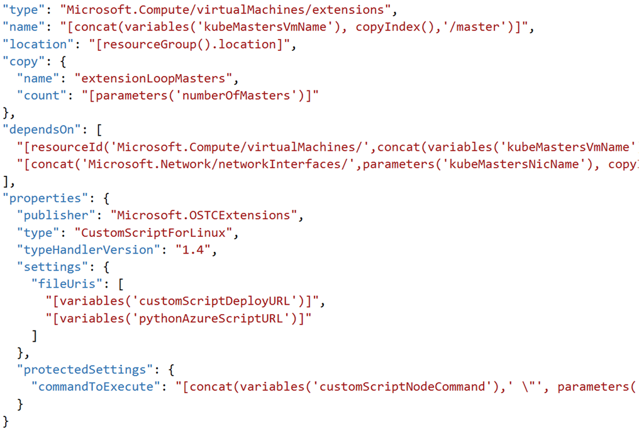
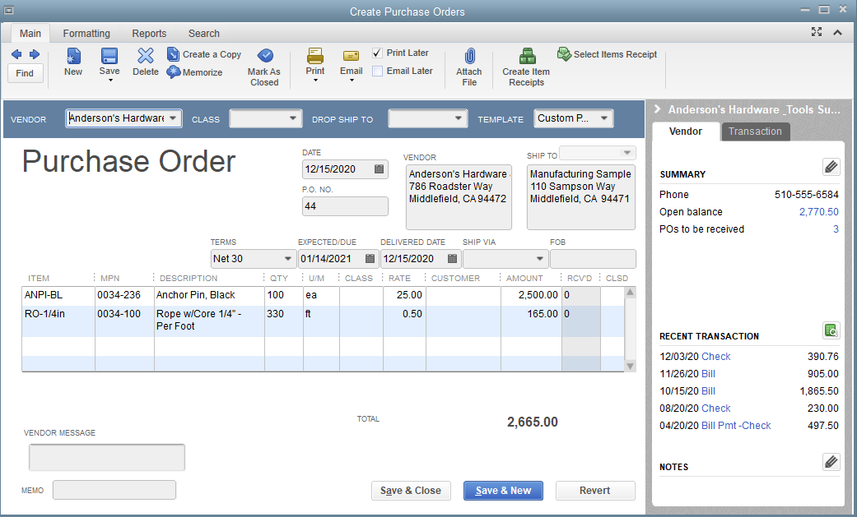
Provisioning Environments
With Documents & Shipping Companies
With APIs
ARM Templates
Terraform Deployments
Helm
CNAB

Slide 6
What is a “cloud”
Point Of Presence
Continental & regional deployment, providing cross region connectivity
Resources Provisioned On Demand
Pay for the usage
On Prem
With Azure Stack, On-prem is an option to extend Azure owned regions to your points of presence
On The Go
With Azure Stack Edge, any location is possible
Hardened, mobile backpacks to temporary shipping container deployments
Notes:
SPEAKER: What is cloud native
‘Cloud-native’ is an adjective that describes the applications, architectures, platforms/infrastructure, and processes, that together make it economical and possible for us to quickly respond to changing landscape and growing customer needs.
In simple terms, it is application code and dependencies packaged in containers, deployed as microservices, and exposed as APIs. And you can manage them using DevOps processes and tools.

Slide 7

Why cloud native?
Speed of innovation
Flexibility Of Choice
Security at scale
Reliability
Notes:
SPEAKER: What can cloud native help you achieve
Rather than dwelling too much on technical terms, what’s more important is what they can help you achieve, putting you and your people into the picture.
Speed of innovation: A cloud-native development model – i.e, microservices - brings back the immediacy of creating code (developers can create something and then actually see it run with transparent feedback loop), empowering your development team to do their best with velocity. By enabling self-service resource access and DevOps practices, teams can eliminate the risk of failure or delay due to human error as staff focus on automated improvements to replace routine, mundane admin tasks.
Reliability: Applications built with cloud native approach in mind can help you get the most of cloud, which means availability, resiliency, scalability and low latency and freedom from redundant operational tasks. Using managed services designed for cloud scale and performance, you can now switch cloud goals from IT cost savings to being the engine of business growth.
Security: Between agility and security, there should not be any trade off. With cloud native technologies, you can automate security checks, run intelligent threat detection and protection real-time, and put fine-grained guardrails at every layer from the metal to a container image – reducing the risk of breach.
To compete effectively, enterprises need to create an environment where developers can do their best work and Ops have the confidence of reliability, security and compliance. That requires the best cloud designed for modern constructs like containers, DevOps, APIs and managed services – and the fluidity to work across environments and teams.

Slide 8
Strongest developer experience¹
Most complete tool chain from Git to production
Serverless scaling with no infrastructure to manage
Speed of innovation
Fully managed database services with >99.999-percent high availability
Single-digit millisecond latencies on reads and writes
Available in more regions than any other cloud providers
Reliability
$1BN investment every year in security
>90 compliance certifications
Out of the box integration with Azure Policy, Active Directory and Security Center
Security at scale
¹Forrester New Wave for Public Cloud Enterprise Container Platforms
Notes:
SPEAKER: Why Azure for cloud native applications?
Azure helps you realize the benefits of adopting cloud native
According to Forrester, Azure offers the strongest developer experience and most complete tool chain
Our fully-managed database service offer up to 99.999% high-availability

Slide 9
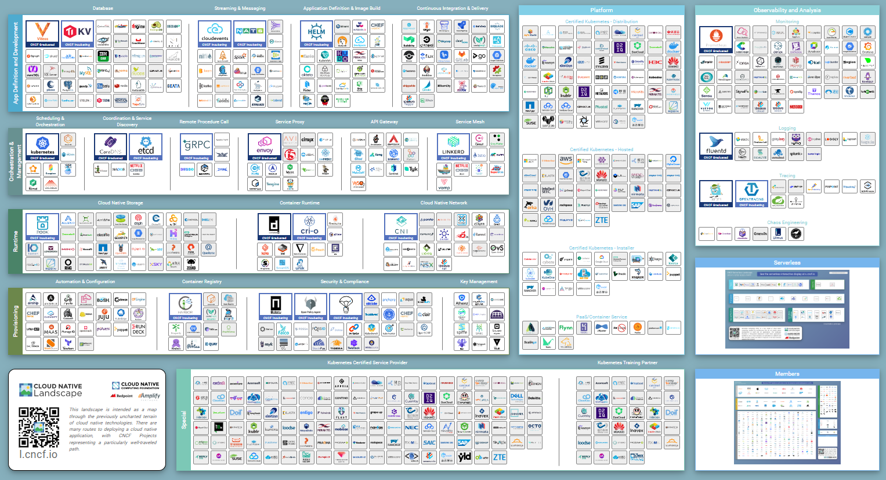
Cloud Native Enables Choice

Slide 10
Serverless

Slide 11
– Mainframes
CIRCA 1980

Slide 12
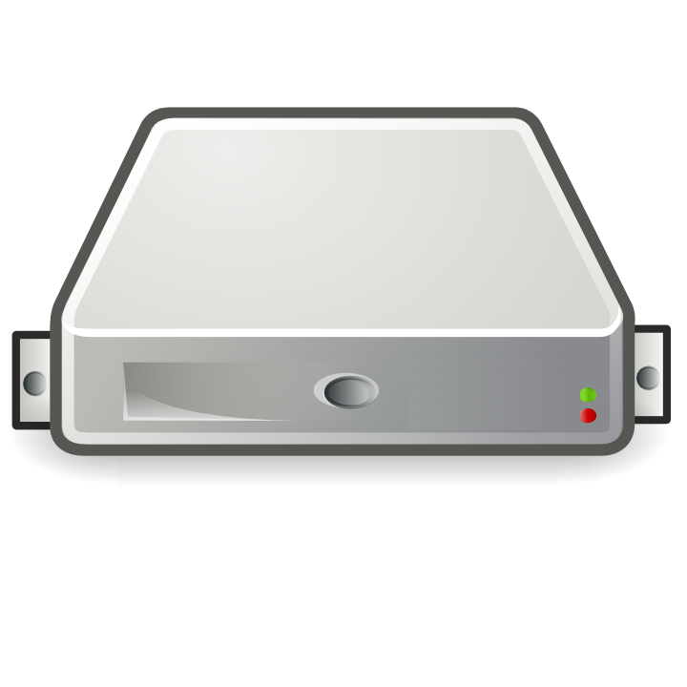
– PC → Server Revolution
CIRCA 1990
$
$
$
$
$
$
$
$
$
$
$
$
$
$
$
$
$
$
$
$
$
$
$
$
$
$
$
$
$
$
$
$
$
$
$
$
$
$
$
$
$
$
$
$
$
$
$
$
$
$
$
$
$
$
$

Slide 13
– Server → VM Evolution
CIRCA 2000
Guest OS #5
Guest OS #6
Guest OS #7
Guest OS #8
Guest OS #5
Guest OS #6
Guest OS #7
Guest OS #8
Guest OS #5
Guest OS #6
Guest OS #7
Guest OS #8
Guest OS #5
Guest OS #6
Guest OS #7
Guest OS #8
Guest OS #5
Guest OS #6
Guest OS #7
Guest OS #8
Guest OS #1
Guest OS #2
Guest OS #3
Guest OS #4
Guest OS #1
Guest OS #2
Guest OS #3
Guest OS #4
Guest OS #1
Guest OS #2
Guest OS #3
Guest OS #4
Guest OS #1
Guest OS #2
Guest OS #3
Guest OS #4
Guest OS #1
Guest OS #2
Guest OS #3
Guest OS #4
Hyper Visor
Hyper Visor
Hyper Visor
Hyper Visor
Hyper Visor
$
$
$
$
$

Slide 14
– VM → Cloud Evolvement
CIRCA 2015
Guest OS #5
Guest OS #6
Guest OS #7
Guest OS #8
Guest OS #5
Guest OS #6
Guest OS #7
Guest OS #8
Guest OS #5
Guest OS #6
Guest OS #7
Guest OS #8
Guest OS #5
Guest OS #6
Guest OS #7
Guest OS #8
Guest OS #5
Guest OS #6
Guest OS #7
Guest OS #8
$
$
$
$
$
$
$
$
$
$
$
$
$
$
$
$
$
$
$
$
Guest OS #1
Guest OS #2
Guest OS #3
Guest OS #4
Guest OS #1
Guest OS #2
Guest OS #3
Guest OS #4
Guest OS #1
Guest OS #2
Guest OS #3
Guest OS #4
Guest OS #1
Guest OS #2
Guest OS #3
Guest OS #4
Guest OS #1
Guest OS #2
Guest OS #3
Guest OS #4
$
$
$
$
$
$
$
$
$
$
$
$
$
$
$
$
$
$
$
$
Hyper Visor
Hyper Visor
Hyper Visor
Hyper Visor
Hyper Visor

Slide 15
– Cloud → Containerization
CIRCA 2015
Guest OS #2
Guest OS #2
Guest OS #2
Guest OS #2
Guest OS #2
$
$
$
$
$
Guest OS #1
Guest OS #2
Guest OS #3
Guest OS #4
Guest OS #1
Guest OS #2
Guest OS #3
Guest OS #4
Guest OS #1
Guest OS #2
Guest OS #3
Guest OS #4
Guest OS #1
Guest OS #2
Guest OS #3
Guest OS #4
Guest OS #1
Guest OS #2
Guest OS #3
Guest OS #4
$
$
$
$
$
Hyper Visor
Hyper Visor
Hyper Visor
Hyper Visor
Hyper Visor

Slide 16
Containers as a 1st Class Primitive
Distributed, Scalable Mainframe
CIRCA 2017
Azure Container Instances

Slide 17
Cloud Capacity
Reserved capacity is a step towards on-demand – it’s a matter of scale

Slide 18

Any workload, anywhere
Microsoft Confidential

Slide 19
Idempotent based Reliable Systems

Slide 20


Bank Of Blue
Bank Of Green
Clearing House
Bank Of Yellow

Slide 21



Queue Manager
Workers (aka minions)

Slide 22

Developer productivity
Security and compliance
Operational simplicity
Any workload, anywhere
Any workload, anywhere
From Windows to Linux containers, from public cloud to IoT Edge, use Kubernetes to orchestrate anything running anywhere
35+ regions and counting
for various OS distributions
across various environments
Public cloud
On-premises
IoT Edge
Linux
Windows
Microsoft Confidential

Slide 23



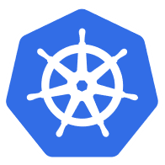

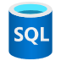



Developer productivity
Security and compliance
Operational simplicity
Any workload, anywhere
Azure Hybrid
Innovation anywhere with Azure
Microsoft Azure
Microsoft Azure
Azure Stack
Azure Arc
Azure IoT
Integrated systems
Any datacenter, any cloud
Any edge device
Management | Security + Identity | App + Data Services | Dev Tools + DevOps

Slide 24
Developer productivity
Security and compliance
Operational simplicity
Any workload, anywhere
Azure Arc
Bring Azure services and management to any infrastructure
Run Azure data services anywhere
Extend Azure management across your environments
Adopt cloud practices on-premises
Implement Azure security anywhere
Azure Arc is a set of technologies that extends Azure management and enables Azure services to run across on-premises, multi-cloud, and edge.

Slide 25


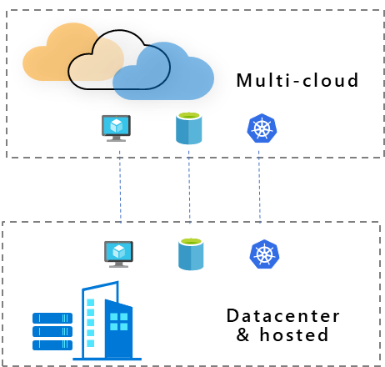
Developer productivity
Security and compliance
Operational simplicity
Any workload, anywhere
Azure Arc
Customer use cases
Multi-cloud
Datacenter & hosted
Organize and govern across environments
At-scale Kubernetes app management
Run data services anywhere
Get Kubernetes clusters and servers that are sprawling across clouds, datacenters and edge under control by centrally organizing and governing from a single place.
Deploy and manage Kubernetes applications at scale across environments using DevOps techniques. Ensure that applications are deployed and configured consistently from source control, at scale.
Deploy and manage data services where you need it for latency or compliance reasons. Always use the most current technology and seamlessly manage and secure your data assets across on-premises, clouds and edge.

Slide 26


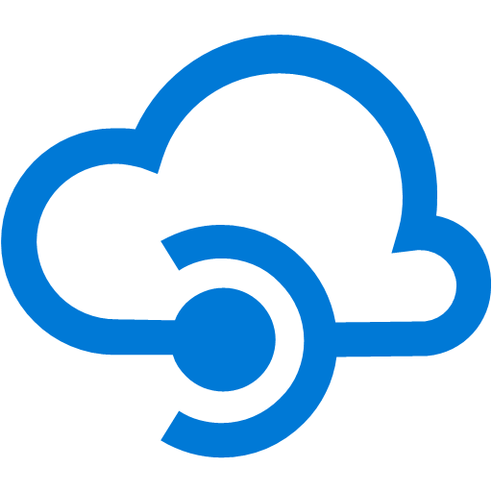
Developer productivity
Security and compliance
Operational simplicity
Any workload, anywhere
At scale Kubernetes app management
Extend Azure management across your environments
Adopt cloud practices on-premises
Implement Azure security anywhere
VSCode
GitHub
Azure Arc with centralized security and governance
Connect & onboard
Inventory
Configure & deploy
Monitor
CI/CD, GitOps
Azure services for example
Kubernetes AKS-like management
Marketplace
APIM
Databases
AI
On-premises, multi-cloud, edge
Microsoft Confidential
Notes:
Announcing Azure Arc, Azure Data Services, and Azure Arc enabled Kubernetes clusters
Businesses today face increasingly complex environments, including thousands of apps, diverse hardware and infrastructure, and multiple clouds. As a result, customers need to enable innovation and developer agility; govern and operate disparate environments at scale; and ensure integrated security across the entire organization.
Azure Arc enables Azure services anywhere and extends Azure management to any infrastructure for unified management, governance and control across clouds, datacenters and edge. They look and feel just like Azure resources, and they provide unified auditing, compliance, and role-based access control across multiple environments and at scale.
As a result, customers can modernize any infrastructure with cloud management and security protection. With cloud practices that work anywhere Microsoft is delivering these resources from cloud to datacenter to edge, and enabling cloud security anywhere.
Azure Arc for management of Windows and Linux servers on any infrastructure is available in public preview on Nov. 4. Azure Arc for management of Kubernetes clusters and Azure data services anywhere (Azure PostgreSQL and Azure SQL Database) are available in preview.
To start using these services, including preview, customers need to have an Azure subscription, download and install Azure Arc software such as Azure Arc Server agent, Azure Arc Kubernetes agent, or Azure Arc Data Manager.
For more information, see our blog post, or contact WE Azure Cloud AI <WEAzureCloudAI@we-worldwide.com>
Tags: Azure Arc, Azure, Azure Resource Manager

Slide 27

Developer productivity
Security and compliance
Operational simplicity
Any workload, anywhere
Azure Arc enabled Kubernetes clusters
Central inventory and monitoring of the sprawling assets running anywhere from on-premises to edge
Consistently apply policies, role-based-access-controls (RBAC) for at-scale governance
Deploy Kubernetes resources to all clusters using a GitOps-based workflow
Identity
RBAC
Policy
Monitoring
Azure Arc
Azure Stack
Anywhere
Kubernetes
Private Preview Q4 CY19
…or…
Microsoft Confidential
Notes:
Azure Arc enabled Kubernetes clusters (Private preview)
Lots of enterprises now have Kubernetes deployments spread across multiple environments – public cloud and on-premises - and are faced with the complexity of managing and securing related resources in a compliant manner. To address it, we are announcing private preview of Azure Arc for Kubernetes that brings Azure security and governance to any Kubernetes deployment. By installing Azure Arc Kubernetes agent, just through simple commands you can register a Kubernetes cluster running on-premises (or any other cloud) in Azure.
Azure Arc enabled Kubernetes clusters are treated like another other Azure resource - you can track and monitor all your clusters inside Azure portal, centrally apply policies and role-based-access-controls (RBAC).

Slide 28
Developer productivity
Security and compliance
Operational simplicity
Any workload, anywhere
Kubernetes on Azure Stack Hub
Easily provision Kubernetes clusters on Azure Stack​ Hub
Automate creation, update and deletion of cluster using simple commands
Fully supported by Microsoft in environments that are connected to the Internet or disconnected
Kubernetes in the cloud
Kubernetes on-premises
Generally available Q4 CY19
Microsoft Confidential
Notes:
Kubernetes on Azure Stack Hub (GA).
Kubernetes on Azure Stack Hub is now generally available. You can now easily provision Kubernetes clusters on Azure Stack and automate the creation, update, patching and deletion of these clusters using simple command lines. It is fully supported by Microsoft for both internet connected and disconnected environments.

Slide 29

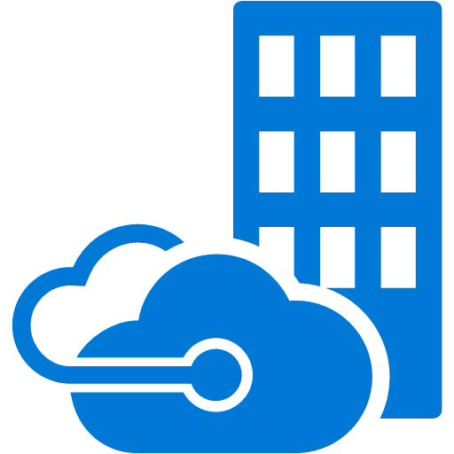
Developer productivity
Security and compliance
Operational simplicity
Any workload, anywhere
Azure Monitor for containers in hybrid environments
Create alerts and get insights into the performance of your on-premises workloads along with your AKS workloads in the Azure portal
Supports Kubernetes deployments on-premises and on Azure Stack
Azure Kubernetes Service
Azure Monitor for containers
On-premises Kubernetes
Azure Stack
Public Preview Q4 CY19
Microsoft Confidential

Slide 30

Developer productivity
Security and compliance
Operational simplicity
Any workload, anywhere
How Azure Arc-enabled Kubernetes clusters work
RP Connected cluster
MSI Service Connected cluster
Arc Agent
Azure Resource Manager
Managed identity
Cluster agent
Helm deployment
API server
Private key secret
GET MSICert
Active Directory
Operator AzureClusterIdentity
GET MSIToken
Microsoft Confidential

Slide 31
Developer productivity
Security and compliance
Operational simplicity
Any workload, anywhere
Config store
How Azure Arc-enabled Kubernetes clusters work
Cluster Config RP extends AKS, connected clusters
Cluster config data plane service
Config
RP Connected cluster
MSI Service Connected cluster
GETS the config
PUTS compliance status
Arc Config
Azure Resource Manager
Managed identity
Cluster agent
Cluster config agent
Make changes
API server
Private key secret
GET MSICert
CRD Azure cluster identity
Role and RoleBinding
GitHub
Active Directory
Controller AzureClusterIdentity
Cluster config. operator
Flux operator
Poll for changes
GET MSIToken
Microsoft Confidential

Slide 32

Developer productivity
Security and compliance
Operational simplicity
Any workload, anywhere
Azure Arc enabled API management
Unified API management across hybrid and multi-cloud environments.
Increase visibility and discoverability of APIs in your organization by providing a single, unified view.
Improve latency, reduce cost, and meet compliance by keeping APIs and data local to the hybrid or multi-cloud environment.
End points
Azure API Gateways
Azure API Management
API 1
API 2
API 3
Azure
Other clouds
On-prem
Public Preview Q4 CY19
Microsoft Confidential
Notes:
the means by which data is communicated between independent services
transition from only offering a product with a single purpose, into a massive platform that partners, developers, or customers can leverage

Slide 33




Container Orchestration & Reliability
Designing with the knowledge something will fail at any point

Slide 34
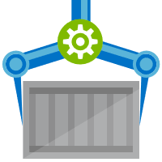


Orchestration Provides Infrastructure Resiliency
Release Management
Resource Pool
Orchestration
HOST-A
Deploy:
web:1 x3
quotes:1 x3
important:1 x4
Image Cache
3
web:1
digest: 91e
web:1
digest: 91e
Foo:
web:1 x3
quotes:1 x3
important:1 x4
web:1
digest: 91e
quotes:1
digest: u82
Container Builder
important:1
digest: 2re
important:1
digest: 2re
Container Registry
HOST-B
Image Cache
quotes:1
digest: u82
quotes:1
digest: u82
7
6
quotes:1
digest: u82
5
web:1
digest: 91e
important:1
digest: 2re
important:1
digest: 2re
important:1
digest: 2re
quotes:1
digest: u82
1
quotes:1
digest: u82
docker build –t web:1
docker build –t quotes:1
docker build –t important:1
docker push web:1
docker push quotes:1
docker push important:1
important:1
digest: 2re
important:1
digest: 2re
Image
web:1
quotes:1
important:1
2
Digests
91e
u82
2re
web:1
digest: 91e
HOST-C
quotes:1
digest: u82
4
important:1
digest: 2re
8
Image Cache
quotes:1
digest: u82
quotes:1
digest: u82
important:1
digest: 2re
important:1
digest: 2re
Notes:
Orchestrator icon from: http://cdn.marketplaceimages.windowsphone.com/v8/images/f58edb21-b20c-4315-b837-6cee21n442cd?imageType=ws_icon_large
https://git-scm.com/book/en/v2/Git-Branching-Basic-Branching-and-Merging

Slide 35

Securing Container Workflows

Slide 36
Securing Container Workflows
Registry access limited through granular roles ^{(push, pull, delete, …)}
Repository scoped RBAC
Restrict image:tag updates with Repository & Tag Locking
Building images securely with ACR Tasks
Signing Images with Content Trust
Build cache is secured with Premium Files
Build artifacts encrypted at rest within ACR
Artifacts are quarantined, pending scanning
Scan results surfaced in ACR
Registry endpoint restricted through VNet & Firewall Rules

Slide 37



Security isn’t definitive it’s a matter of time, effort and how determined someone is.

Slide 38


Multiple Lines Of Defense

Slide 39


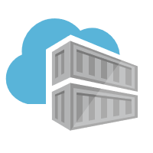


Authentication & Authorization
Require the most stringent authentication
Users – 2fa
Services – rotatable, revocable, time-based tokens
Provide the least permissions required to get the job done.
Runtime clusters should only be able to pull
CI Systems should be able to push
Teams & clusters should have different permissions
Who can sign images?
Authentication:
Username/Password?
2FA
Token
Certificate
Time based
Revocable?
Permissions:
Read – Pull
Write – Push
Sign – content trust
List – repos and tags
Delete
Update meta-data – expiration date
Users
Services

Slide 40

Managing Base Images

Slide 41
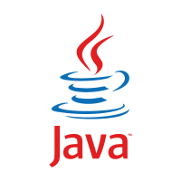




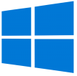

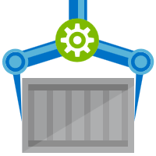






Are Your Base Images Secure?
Buffer base artifacts in your secured environment
Scan, test, validate base artifacts
Automate all of this
Be protected and available, when things outside your control aren’t secured or available
Are Your Base Images Artifacts Secure?
Public Registries
Your Environment
aws, azure, google, on-prem, …
Private Registry
acr, ecr, gcr, dtr, harbor, jfrog, …
.NET
contoso.azurecr.io
Docker Hub
Public Internet
staging-artifacts
node
java
MCR
dotnet
ACR Tasks
wordpress
base-artifacts
node
java
dotnet
wordpress
departments
marketing
warranty
dev
falcon-team
warriors-team

Slide 42






Best support for your enterprise need
Learning path aka.ms/LearnKubernetes
What is Kubernetes aka.ms/k8sLearning
Hear from experts aka.ms/AKS/videos
Case studies aka.ms/aks/casestudy
Azure Kubernetes Service aka.ms/AKS/page
Try for free aka.ms/aks/trial
Feedback on the roadmap? Tell us at https://aka.ms/aks/feedback

Slide 43




Thank You
ACR Tasks aka.ms/acr/tasks
ACR Import aka.ms/acr/import
ACR Tag Locking aka.ms/acr/tag-locking
Tagging Best Practices aka.ms/acr/tagging
Presentations aka.ms/acr/presentations
ACR Links aka.ms/acr/links
Steve Lasker
Program Manager
Azure Container Registries
Steve.Lasker@Microsoft.com
@SteveLasker
SteveLasker.blog
github.com/SteveLasker
github.com/SteveLasker/presentations

Slide 44

Virtual Networks & Firewall Rules
Costs
Compliance
Hybrid
Security
Sovereignty
Availability
Data Locality

Slide 45


Costs
Compliance
Hybrid
Virtual Networks & Firewall Rules
Security
Data Locality
Availability
Sovereignty

